Slide 1
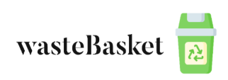
Team lead : Alexandru-Florin BELENGEANU
Hardware Design : Alexandru-Florin BELENGEANU
Software Developer : Alexandru-Florin BELENGEANU
Special thanks : Alexandru-Florin BELENGEANU
HackTM2022

Slide 2
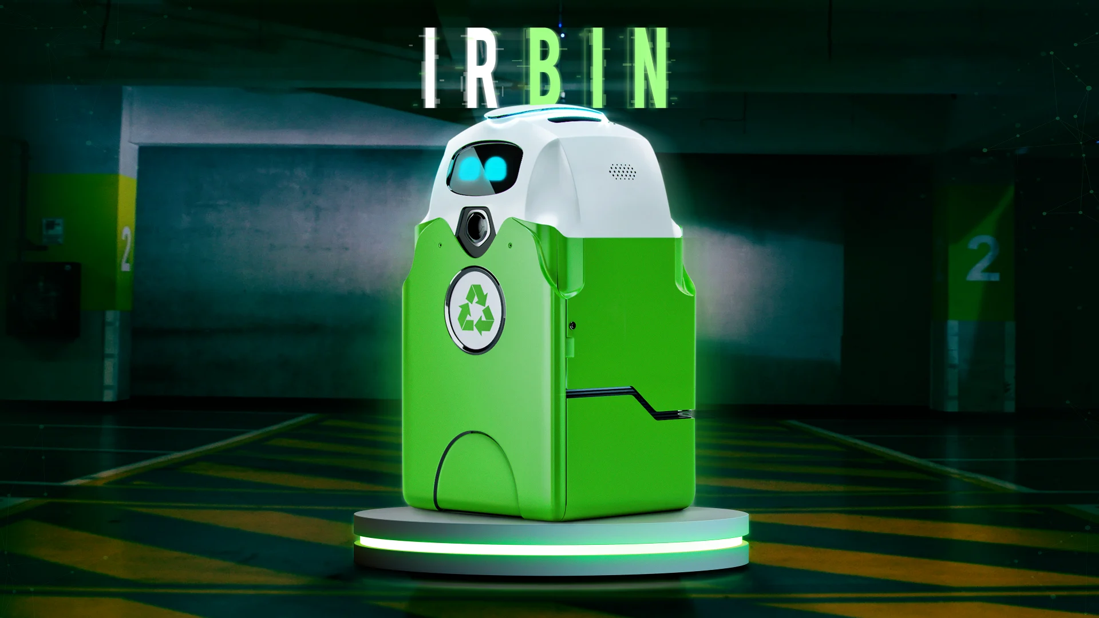
Objectives
The main objective of this project is to create a smart litter sorting system which
should be used in order to minimize human effort, and maximize the amount of
recycled trash worldwide
HackTM2022

Slide 3
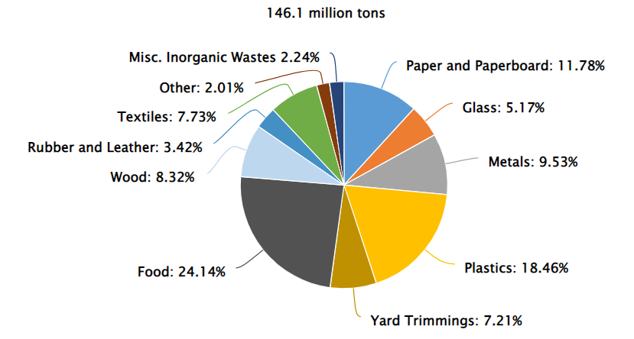
Total Municipal Solid Waste by Material
2018 (USA)
HackTM2022

Slide 4
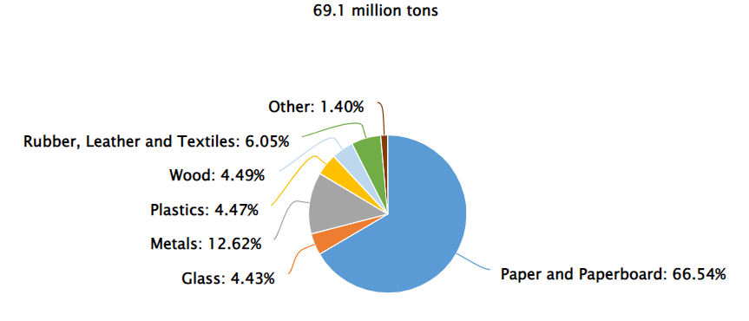
Total Municipal Solid Waste Recycling
by Material 2018 (USA)
HackTM2022

Slide 5
Why people don’t sort garbage ?
“Many cities suffer from the lack of infrastructure regarding recycling. Wherever you go around the town there is only one trash bin, and even if you want to sort the litter, it ends up being tossed together with garbage of other types.”
“It sounds infuriating, but some people can’t be bothered to recycle just because they think it’s hard. We know—no one gets those bins right the first time, but that doesn’t mean you should stop there. Sure, figuring out where plastic, paper, and organic waste goes can sound daunting at first, but it gets easier!”
“They are just lazy.”
Fun Fact : The EPA estimates that 75% of the American waste stream is recyclable,
but they only recycle about 30% of it.
HackTM2022

Slide 6
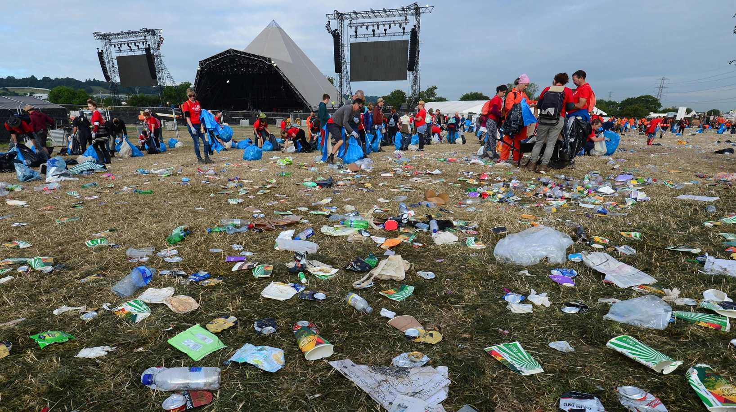
Who’s going to use it ?
The wasteBasket is not mainly designed for households uses, but for commercial centers and crowded places in general(e.g. malls, tourist resorts, festivals, meetings)
HackTM2022

Slide 7
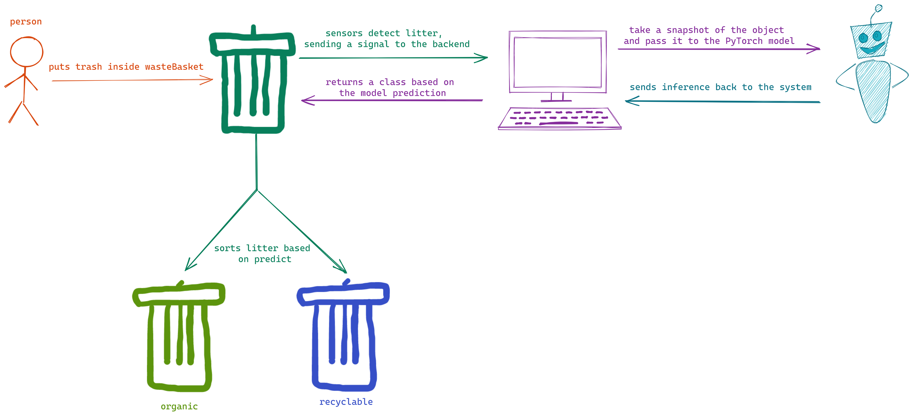
Product Achitecture
HackTM2022

Slide 8
Used Technologies
Arduino Uno with 2 servomotors + 1 ultrasonic sensor for hardware
Python 3.8 for backend (with PyTorch for model training)
Microsoft VS Code for full integrated script
JupyterLab for experiments
System : Acer Nitro i7-8750H CPU @ 2.20GHz, 16GB RAM, NVIDIA GeForce GTX 1050 Ti videocard
HackTM2022

Slide 9
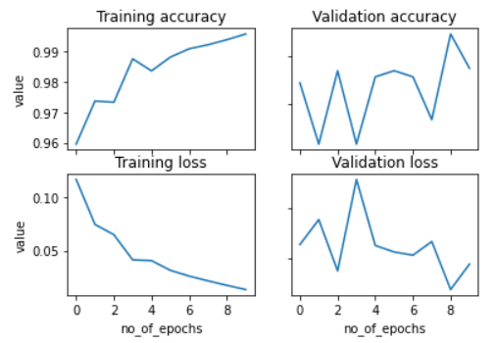
Model used
ResNet18 Architecture trained on my waste dataset
HackTM2022

Slide 10
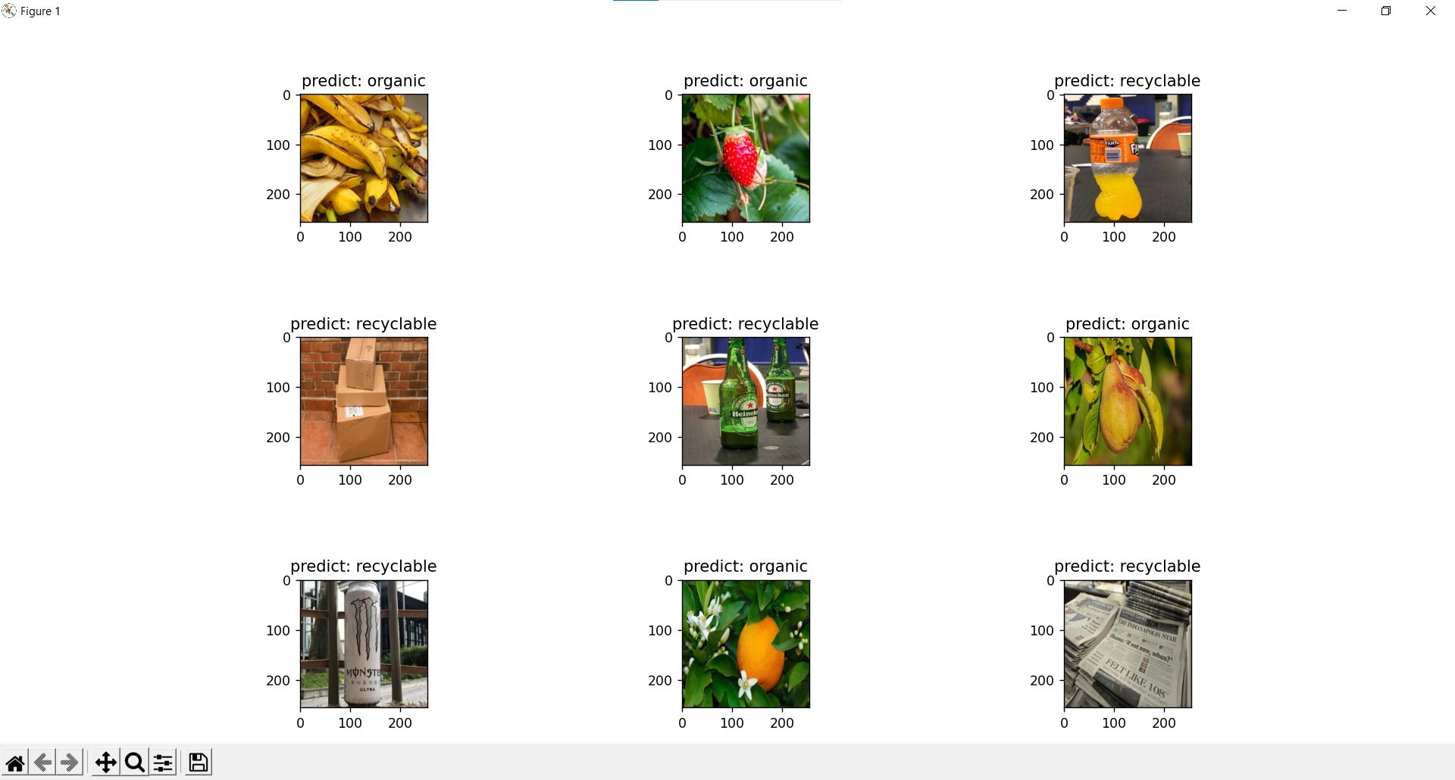
Examples
HackTM2022

Slide 11
Future ideas
Maybe use an ambient light/IR barrier sensor instead of ultrasonic
Add a weight sensor under the garbage platform
Use a proximity sensor to detect when the trash bin is full, and send an alert so an employee
can come and collect the garbage
HackTM2022

Slide 12
Marketing strategy
Costs
650L Trash bin : ~ 200€
Hardware components : ~ 120€
Software licenses : around 1000€ per year, but could differ +-
Advertising : ~5000€ in the first year
Target customers
Shopping centers, resorts, city halls, festivals/concerts
Sales volume estimation
To buy : 800€ per piece, with possibility of discount for bulk buy
To rent : 150€ per day per piece
HackTM2022

Slide 13
Why use wastebasket ?
With the new emerging projects launched by states and city halls,
people get rewarded when they recycle
By purchasing our product, people can reduce the garbage collection price
by more than 50%
Cover the purchase price by lowering the collecting price in ~2 years,
based on state and area ( and also contribute to the decarbonization process ☺ )
HackTM2022

Slide 14
Links
https://www.wundermanthompson.com/work/irbin
https://www.dosomething.org/us/facts/11-facts-about-recycling
https://www.epa.gov/facts-and-figures-about-materials-waste-and-recycling/national-overview-facts-and-figures-materials
https://www.gorillabins.ca/blog/5-reasons-why-people-dont-recycle-and-5-reasons-why-we-should/
HackTM2022

Slide 15
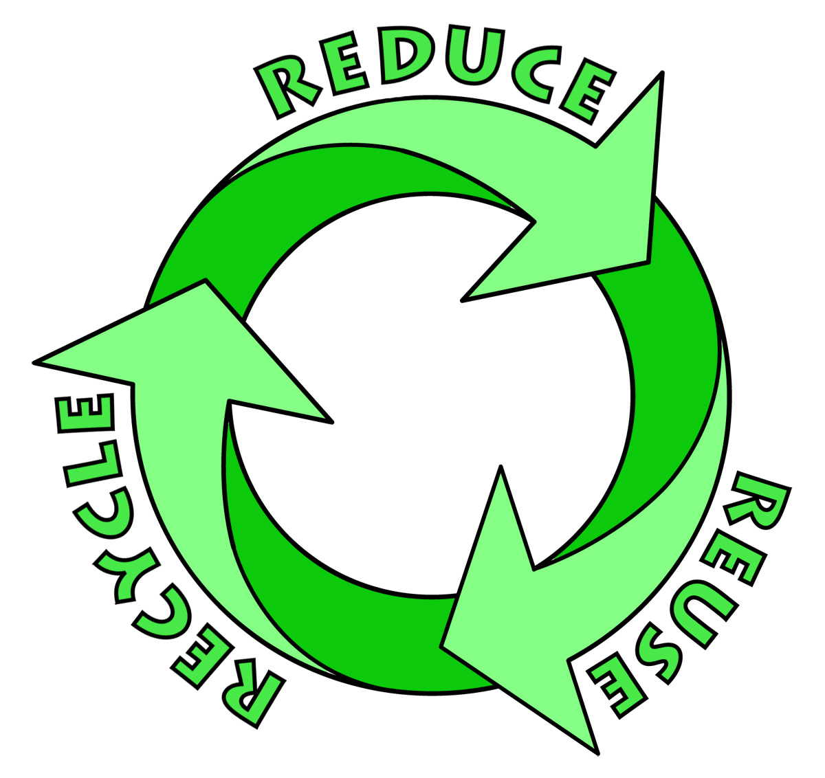
Thank you! ☺
HackTM2022

